Slide 1
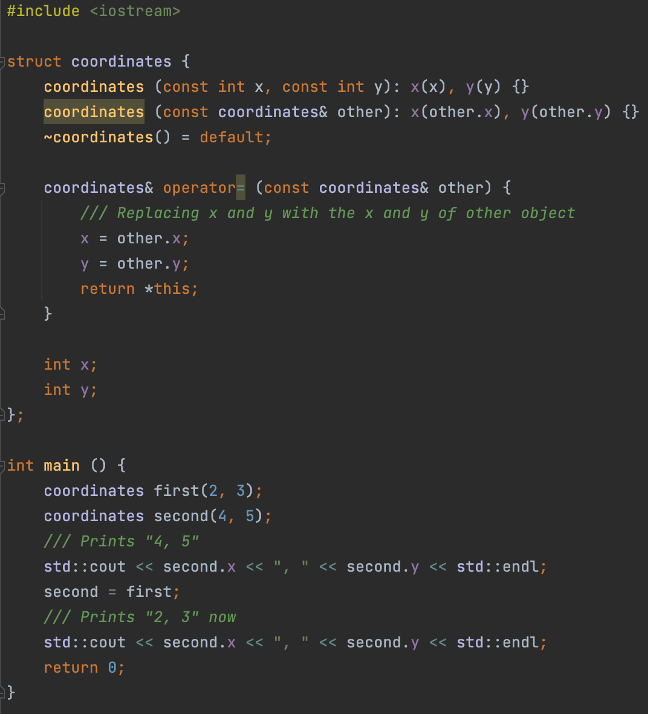
Copy assignment operator
The copy assignment operator allows you to change the content of an already created object by copying the state of another object into it. The difference between the copy assignment operator and the copy constructor is that the copy assignment operator does NOT create a new object, but operates with existing ones.
Defining custom copy assignment operator:
Defining your own copy assignment operator for a class is very similar to defining a method.

Slide 2
Operator= return type
Why operator= does not return void
Let's remember the very first lectures, namely, the lecture about expressions. In it, I talked about expressions of this type:
x = y = z;
For such expressions to work correctly, the result of the expression y = z (which is getting calculated first, of course) must be the value of the object obtained after the assignment.
Why operator= returns a reference
Because in some cases, we need a reference to the object we just assigned to!
(x = y) = z;
In this example, there will be two calls to the copy assignment operator:
x = y, and then x = z

Slide 3
Rule of three, recap
Rule of 3: If a class requires a user-defined destructor, a user-defined copy constructor, or a user-defined copy assignment operator, it almost certainly requires all three.

Slide 4
STL Containers, first cursory overview
Let's look at a few examples of classes built into the standard library that will be useful during homework and exam contest: std::vector, std::array
std::array and std::vector are called containers, they provide some storage for collection (sequence) of objects, or primitives. There are a lot of containers, we will all look at all of them in detail in the second semester.

Slide 5
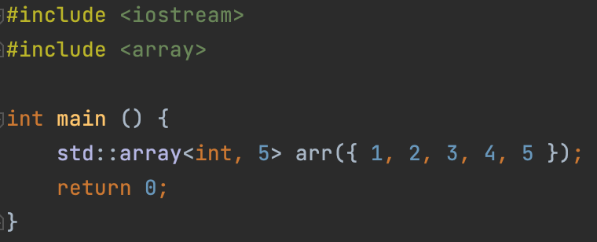
std::array: constructor
std::array is a fixed, non-expandable array. Roughly speaking, it is analogous to C-style-array (for example, int[]). Array owns elements like any container, so we can say that it is using the RAII idiom.
To create an array, you need:
To include <array> header
To pass the type of the array element and the number of elements in the array in triangle brackets (this is called template parameters, we'll talk about how it works later)
To call constructor from std::initializer_list

Slide 6
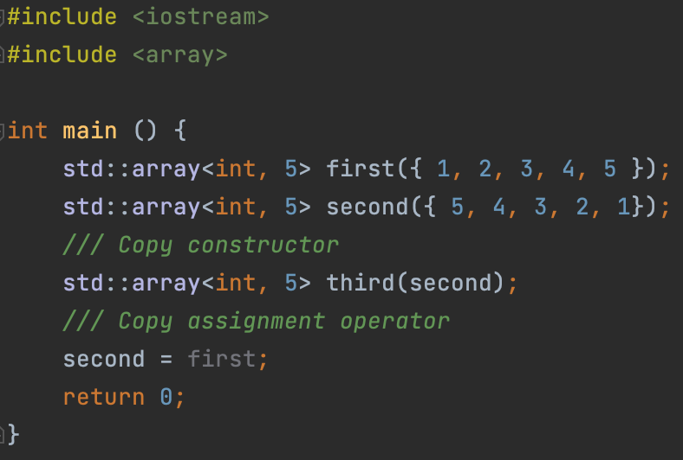
std::array: copy constructor and copy assignment operator
Naturally, the array supports both the copy constructor and the copy assignment operator
Of course, the types and sizes of the arrays must match for copying to be possible!

Slide 7
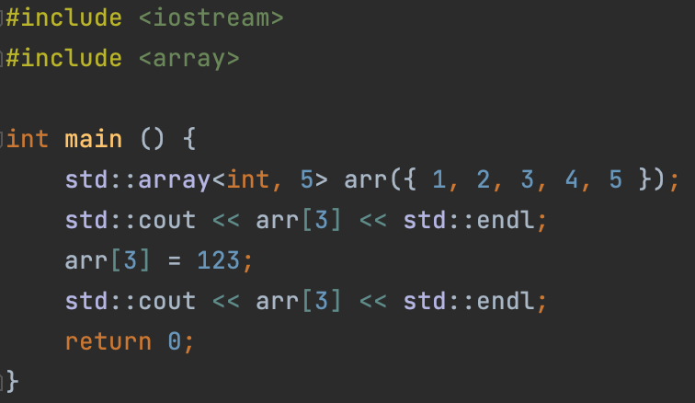
std::array: operator[]
You can use the operator[] to access array elements, just like a regular C-style array. This works because the operator[] is defined for the std::array class. Actually, it’s better to say that it’s REdefined.
The operator[] returns a reference to the i-th element of the array, so we can assign to this reference to change the value of the i-th element, meaning, that the operator[] provides both read access and write access to a specific element. This concept is called an accessor.

Slide 8
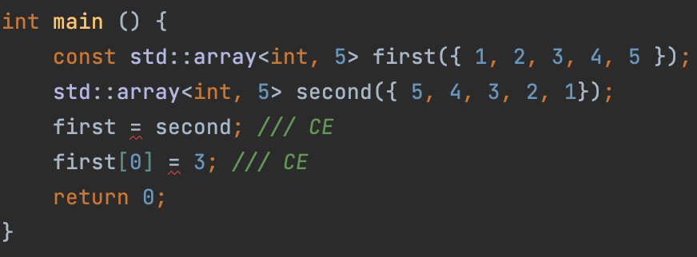
std::array: const qualifier
If we add a const qualifier to the array, we disallow any modifying operations on it:
in a const-qualified array, you cannot copy to it, using copy assignment operator and modify its elements through the operator[].
This is achieved by the fact that the operator[] has two versions: one for a non-const-qualified array, and the other for a const-qualified array.

Slide 9
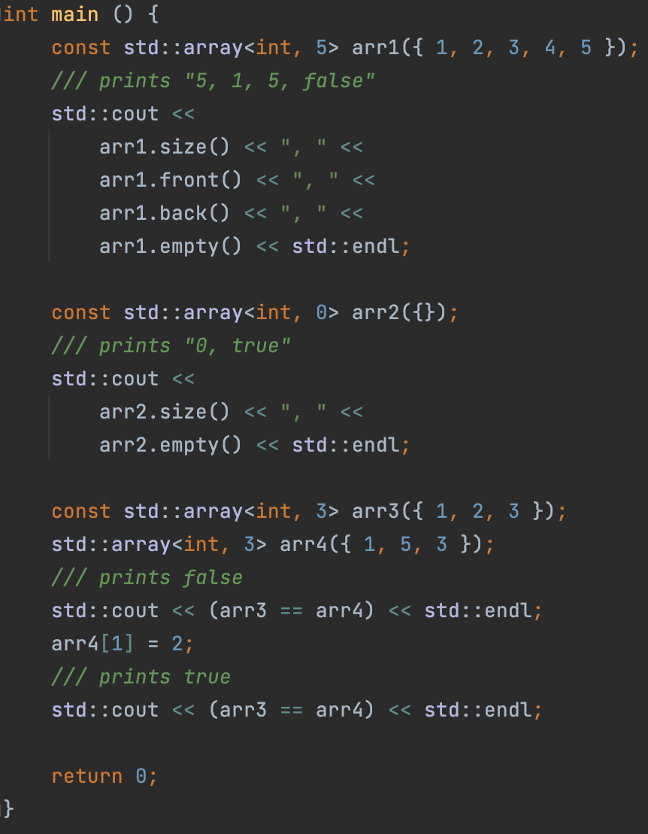
std::array: another useful methods
size() returns the amount of elements in the array
front() is identical to the array[0]
back() is identical to the array[array.size() - 1]
empty() returns true if array is empty, false otherwise
operator== compares two arrays
size() method returns size_t type, which is an unsigned variable, size of which is not less than 2 bytes.
size_t can store the maximum size of a theoretically possible object of any type (including array).

Slide 10
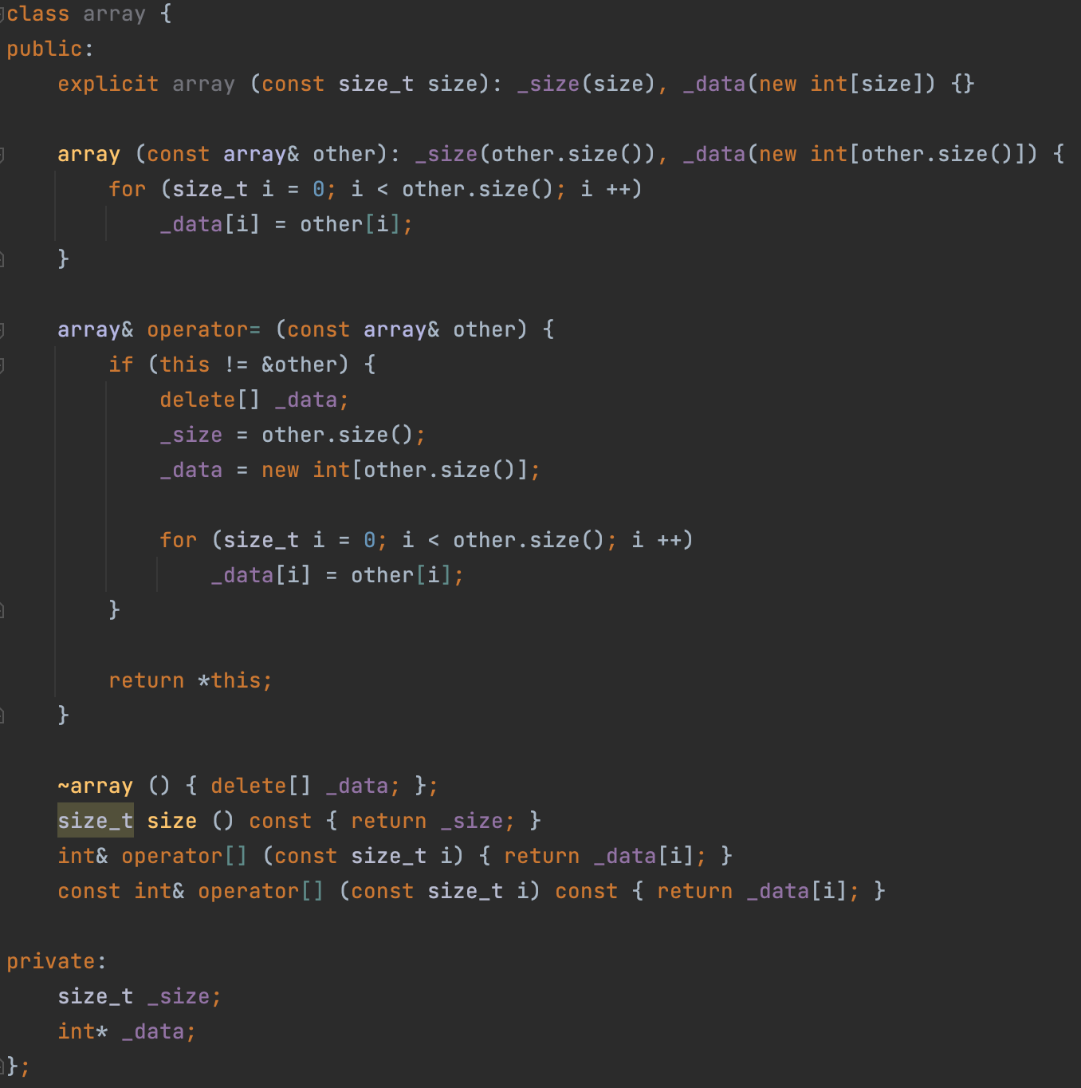
std::array implementation
We will talk about std::vector next time, and today we will implement the non-template version of std::array
Key points:
allocate data in constructor, deallocate in destructor (RAII)
operator= implementation: don’t forget to clear the state before copying
operator= implementation: comparison with &other to avoid copying the object to itself
two differently qualified operators[]: getter and setter
size() method is a getter, it provides only read access to a certain property of an object, thus, it’s const qualified

Slide 11
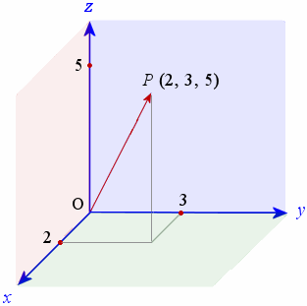
Operator redefinition, practice
C++ allows you to redefine many operators in classes. Let's take a look at this using the vector class as an example (DO NOT Confuse with std::vector!), Which stores the value of a 3D vector in space. Let's implement most of the useful operators in it.

Slide 12
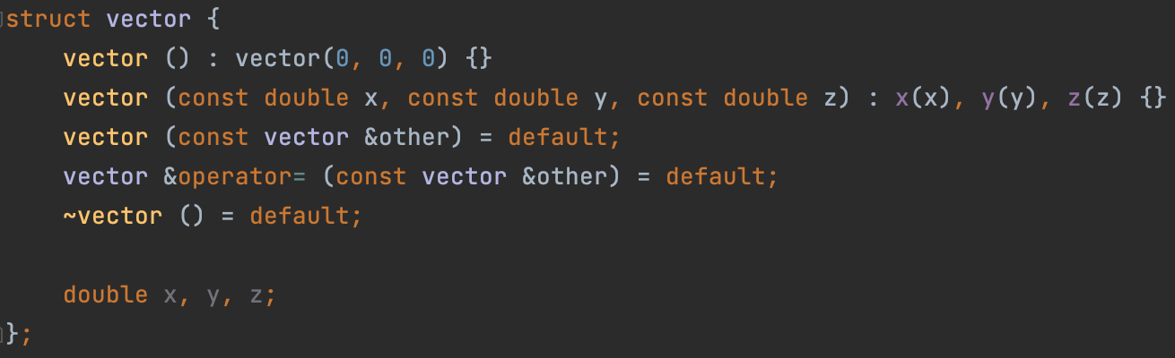
3D Vector: base
First of all, let’s create a class itself. I’ll won’t use encapsulation in order to hide fields x, y and z, because it’s practically useless in this particular case.
Then, I’ll define:
Constructor from three doubles, which will initialize x, y and z variables with values
Default constructor, which will initialize coordinates with zeros by calling delegate constructor from three doubles.
Default copy constructor
Default copy assignment operator
Default destructor

Slide 13
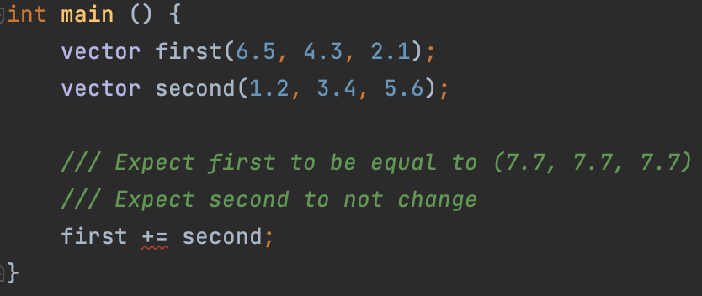
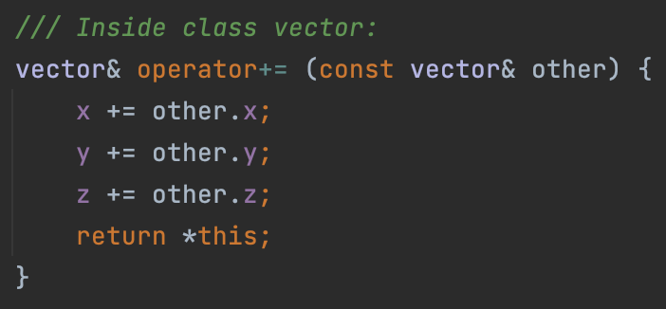
3D Vector: compound assignment operators
First 3D-vector-specific operator, which we’ll redefine will be the compound assignment operator +=
Operator += should not modify its second argument (it should receive it by const reference)
Operator += should be defined in-class and be non-const
Operator += should return ref to the current object similarly to the copy assignment operator
Signature of every the compound assignment operators is similar to copy assignment operator. Implementation is obvious in this case.

Slide 14
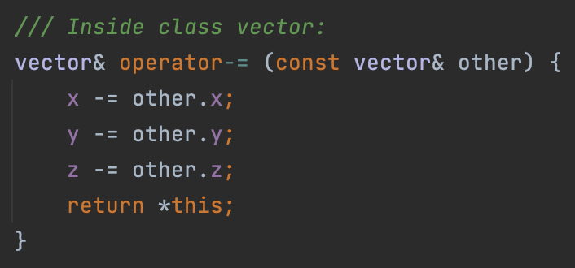
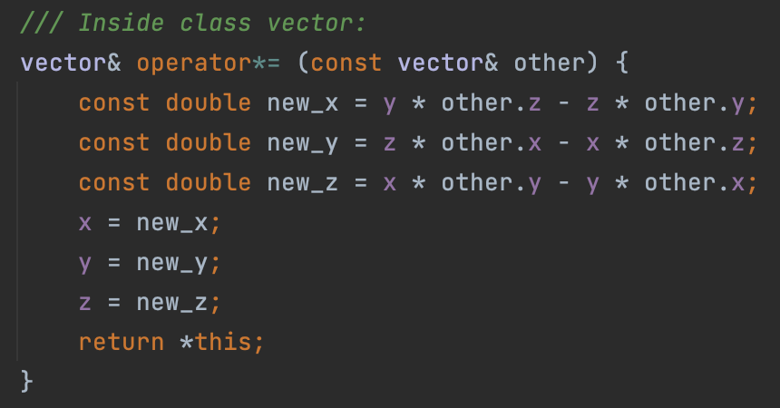
3D Vector: compound assignment operators
Implementation of the operator –= is very similar.
However, implementation of the operator *= is a little more complicated, just because cross product multiplication is a complicated arithmetic operation.

Slide 15
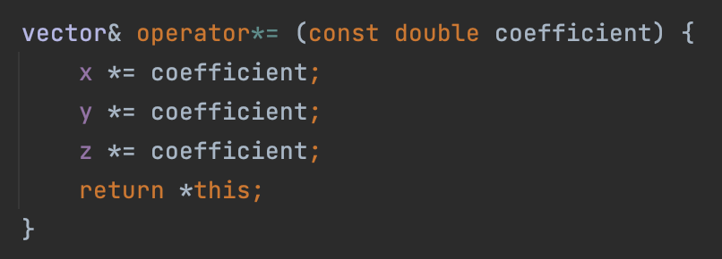
3D Vector: compound assignment operators
Great, we learned how to multiply a vector by a vector. But what if we want to multiply a vector by a number? Let's define a second method * = that will take a number. One definition rule is not violated in this case, because the signatures are different.

Slide 16
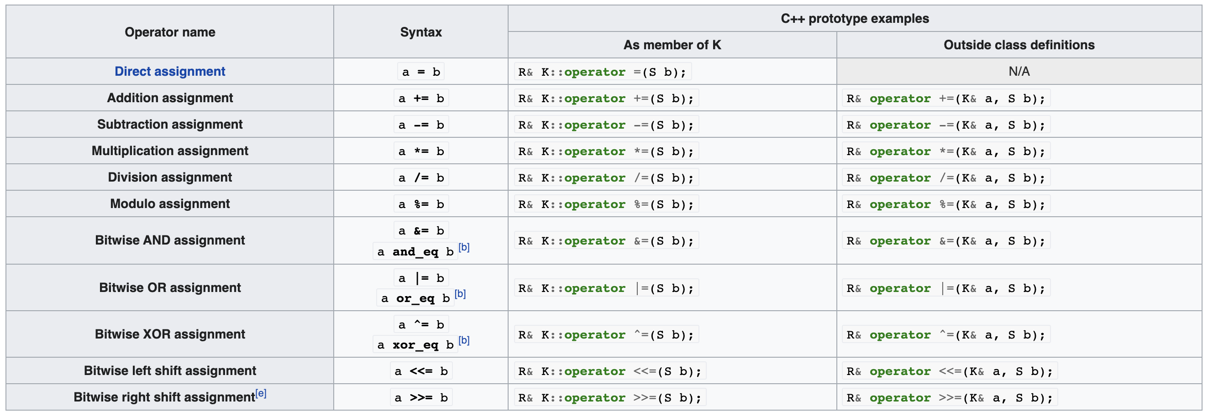
3D Vector: compound assignment operators
Summarizing up the compound assignment operators redefinition topic, I want to say that the examples I have shown is applicable to other compound assignment operators. Every other compound assignement operator can be redefined simply. Here in the table I gave the signatures of these operators:

Slide 17
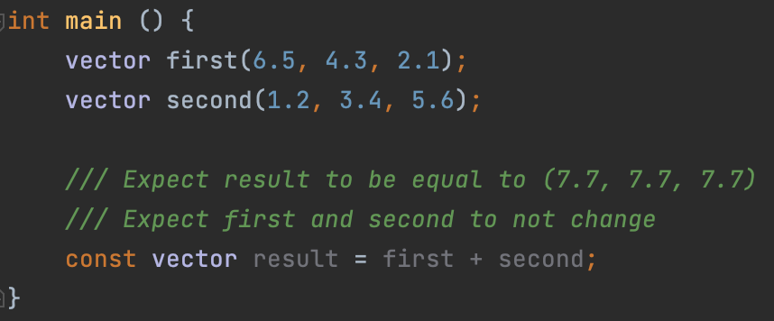
3D Vector: binary arithmetic operators
Sometimes, we don't want to change the state of the original object when calculating the sum. In this case, we want to create a new object that will be the sum of the two original ones.
There are binary arithmetic operators for this:
So, binary arithmetic operators should receive two objects by const references and create new object, which stores the sum.
Since the context of the binary operators is not limited to one object, I recommend implementing them out-of-class, this is the way I will show you.

Slide 18
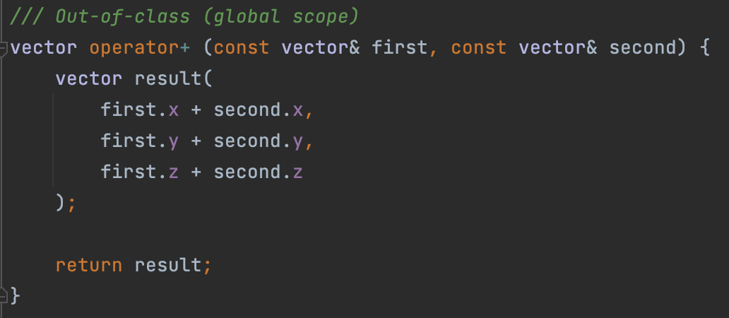
3D Vector: binary arithmetic operators
In the screenshot on the right, I have given a common implementation of the binary operator +. Everything seems to be fine, however, let's note one subtlety: we have defined the logic for summing two vectors again! Remember, we have already done this in the case of the operator +=! It turns out that in this case we accidently utilized copypasting…
In the vector example, it is not clear why this is bad. But, believe me, in our course in the future we will consider more complex classes that have more sophisticated methods of addition. We would not like to use copypaste in this case. Instead of that, why not rely on the operator +=, which we have already implemented?

Slide 19
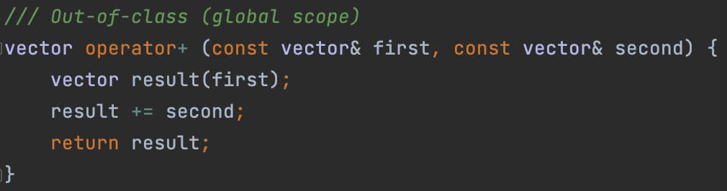
3D Vector: binary arithmetic operators
Above is the correctly defined operator += for the vector class. It consists of three parts:
Making a copy of the first vector
Calling operator += on this copy
Returning the resulting value from a function
This solution can even be written in one line using the concept of temporary object. Let's look at it in order to optimize our solution.

Slide 20
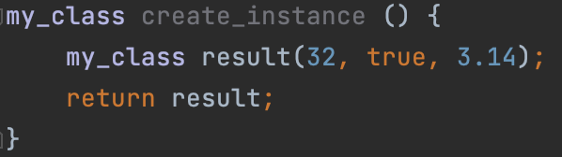
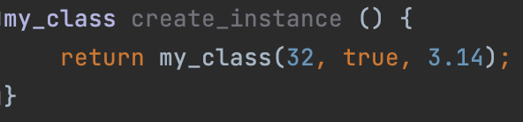
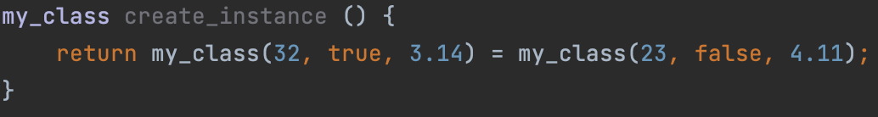
Temporary object
C ++ allows us to create a temporary unnamed object by calling its constructor:
The temporary object can be used both to the left of the assignment operator (lvalue) and to the right (rvalue):

Slide 21
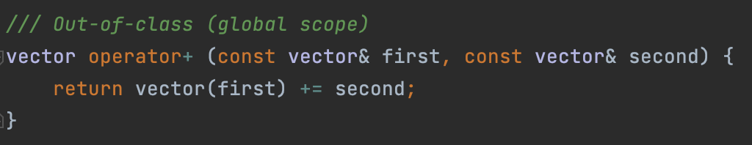
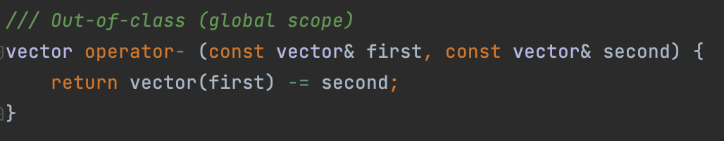
3D Vector: binary arithmetic operators
So let's use the concept of a temporary object to implement the binary operator +:
The advantage of this implementation is its versatility. It will almost always be convenient to define the binary operator + exactly as shown above.
Operator – and operator * can be implemented similarly:

Slide 22
3D Vector: binary arithmetic operators
Let’s support the operator * in case of:
multiplication vector by a vector
multiplication vector by a number
multiplication number by a vector

Slide 23
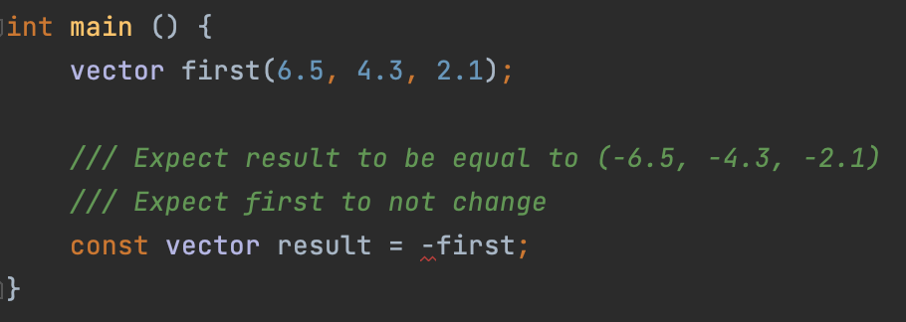
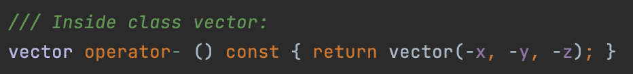
3D Vector: unary arithmetic operators
We may want to get the reflected vector, relative to the origin. In the case of numbers, we use the unary operator – for this task.
Unary arithmetic operators doesn’t change the object they are applied too. Instead, they create a copy of the object. Usually they are defined in-class and, thus, const-qualified:

Slide 24
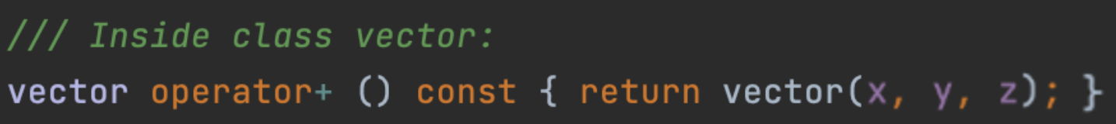
3D Vector: unary arithmetic operators
In addition to the unary operator –, there is also the unary operator +. It might seem like such operator doesn't make sense, because it just copies the value of the vector without changing it. Unfortunately, I cannot yet demonstrate a useful example using this operator, so for now, let's just define it:

Slide 25
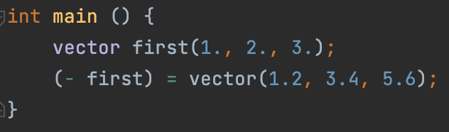
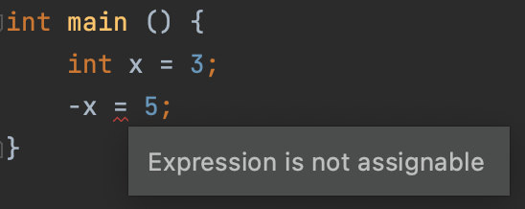
3D Vector: problem with binary and unary arithmetic operators
Consider the following example:
On the second line in the main function, we are assigning to a temporary object. Obviously, such an operation is meaningless, because the temporary object will not be available in the future.
This is allowed because the result of a unary operator – is an lvalue (a value that can be used as the left operand of an assignment operator) in our case.
By the way, in the case of int, this idea will not work.

Slide 26
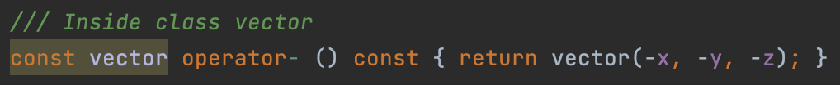
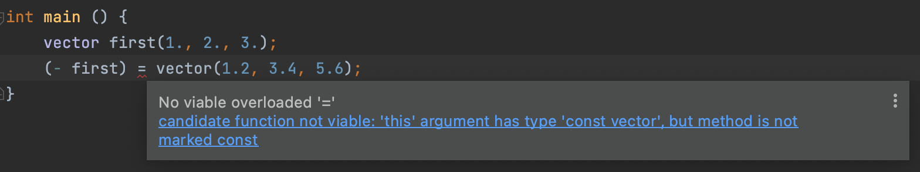
3D Vector: problem with binary and unary arithmetic operators
So how do we fix the problem? The obvious solution is to return an rvalue instead of an lvalue from the operator –. To do this, just add a const-qualifier to the return type of the operator –.
WARNING: do not confuse const-qualifier applied to return type and const-qualifier of a method!
Well, now the same line of code will not work (which is great) and CE will appear:

Slide 27
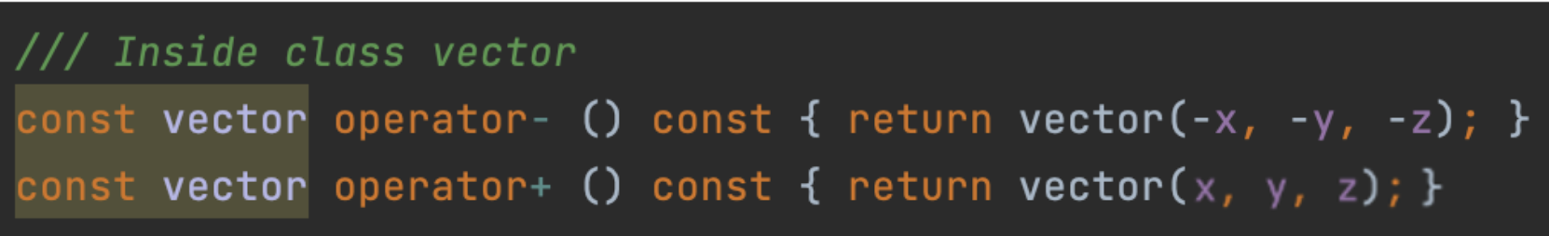
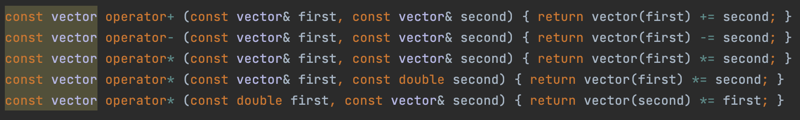
3D Vector: problem with binary and unary arithmetic operators
Let's update the return type in all places where a similar problem might arise.
Note: CLion marked the return type in yellow because this solution is not entirely correct. We'll dive into details later when we will be discussing the so-called reference qualifiers. Later, we will come up with a correct solution of the problem using them. The current solution should be taken as temporary.

Slide 28
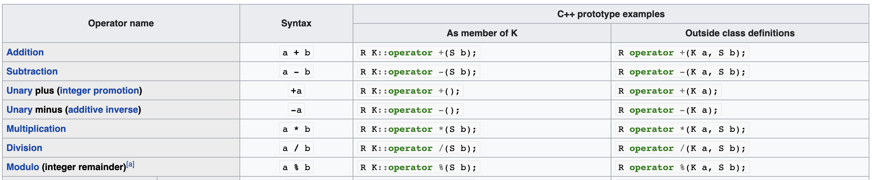
3D Vector: arithmetic operators
Summarizing up the arithmetic operators redefinition topic, I want to show you the table below:
Operators operator / and operator % can be redefined similarly to operators operator +, operator – and operator *.
Just don’t forget that every binary arithmetic operator should be implemented via a corresponding compound assignment operator.

Slide 29
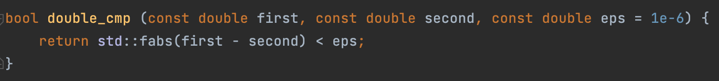
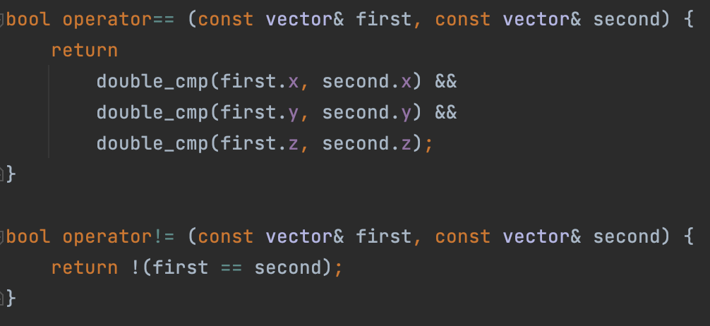
3D Vector: comparison operators
Let's define two helper operators that allow us to compare two vectors with each other: the operator == and the operator !=. Since the coordinates of the vector are real numbers, we will compare them using the algorithm for comparing real numbers.
Please pay attention to the implementation of the operator !=.
It is very important that it refers to the operator ==. Thus, we avoid the tautology (just like with the example about operator += and operator +)

Slide 30
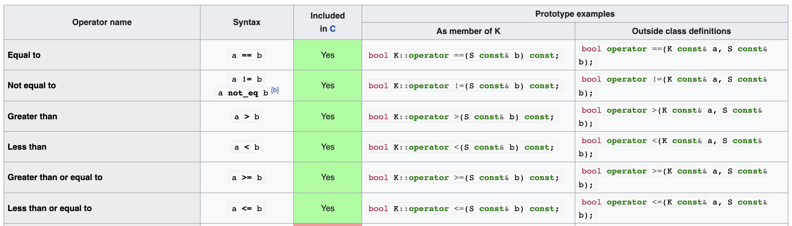
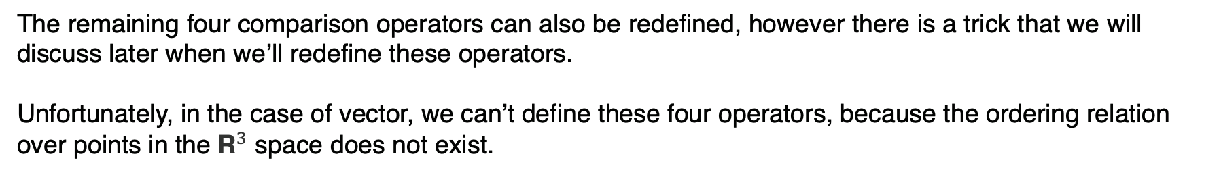
3D Vector: comparison operators
The remaining four comparison operators can also be redefined, however there is a trick that we will discuss later when we’ll redefine these operators.
Unfortunately, in the case of vector, we can’t define these four operators, because the ordering relation over points in the ${\text{R}}^{3}$ space does not exist.

Slide 31
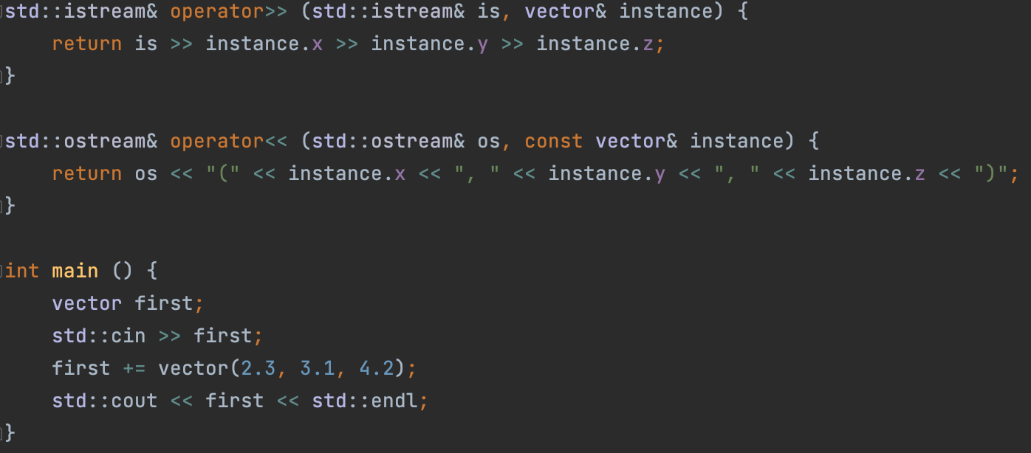
3D Vector: I/O operators
If we want our object to be scannable from the terminal and printable into it, then we have to redefine two binary bitwise shift operators of a special form (accepting std::istream and std::ostream, representing input and output streams, respectively).
Both of these operators must return the reference to the stream they received as an argument. This is necessary in order to support the chain call of operator >> and operator <<

Slide 32
3D Vector: full code
Full code of the vector class can be found here.

Slide 33
Lecture 11
Classes and structures, pt.3
Konstantin Leladze
OOP in C++
DIHT MIPT 2021

